Slide 1
Analyzing effect of Box Office on Unemployment
Pragati Khekale, A20471024
Mounika Gampa, A2048807
Amogh A Kori, A20491465
Rajesh Patel, A20503050

Slide 2
Problem Statements
Analyze how the unemployment rate in US has effect on box office revenue.
Measure how reviews and ratings of movies released in theaters to their sales at the box office.
Another objective of the project is to visualize the analysis.

Slide 3
PROJECT OVERVIEW
Perform data collection of all 4 mentioned distinct datasets (These datasets are raw but obtained from authoritative source which maintains the data quality and authenticity)
Perform Data preparation steps such as: Data observation, cleaning, validating, integration, etc
After we obtain a processed data as a result of the previous steps, now we combine all the processed datasets
While combining keep the relevant fields from the datasets and alter the fields to make the final resulting dataset uniform
Perform Exploratory data visualization and analysis

Slide 4
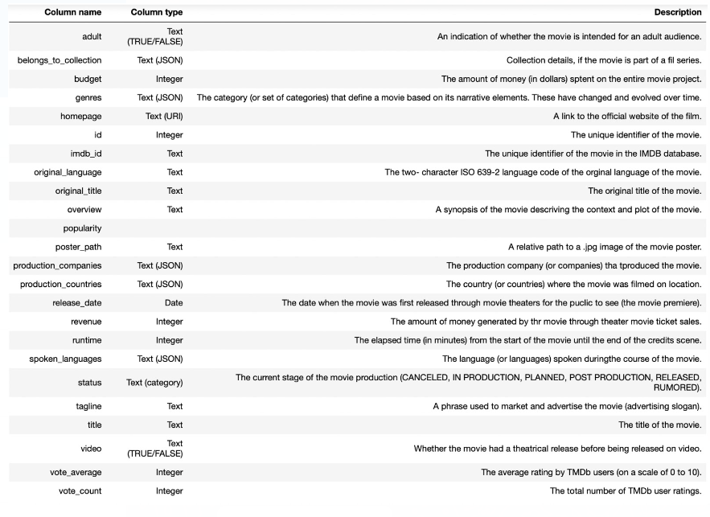
DATA
“Primary Data: The Movies Dataset” - The contents of the movies_metadata.csv are described below.

Slide 5
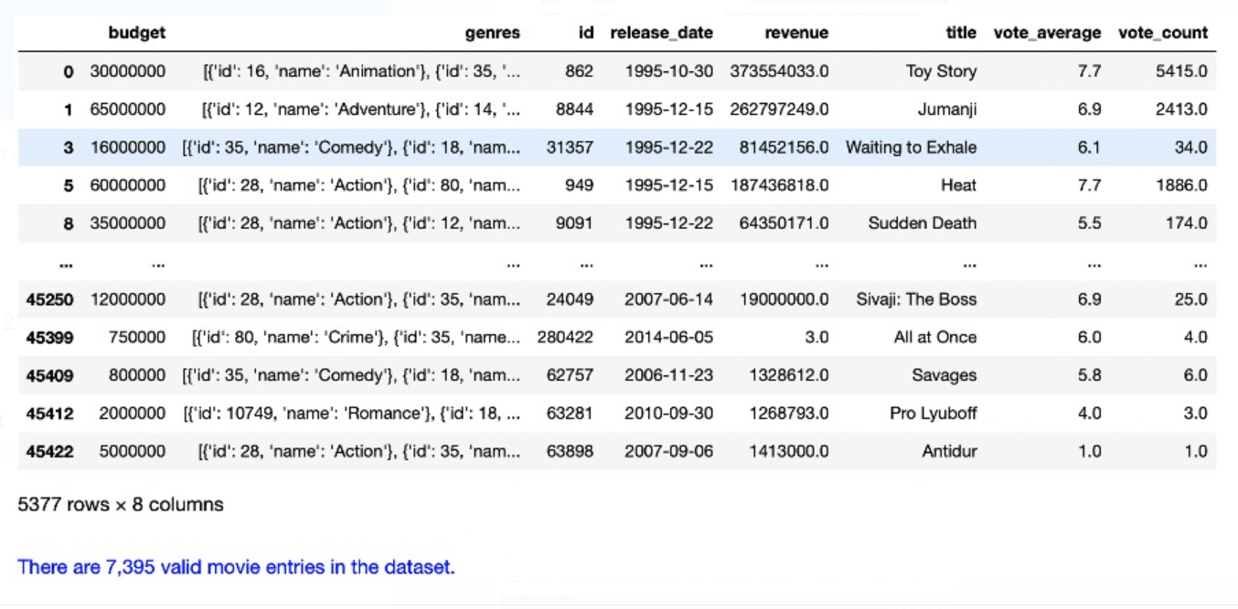
"Secondary Data: IMDB movies extensive dataset” – The contents of the IMDB movies.csv dataset are described below

Slide 6
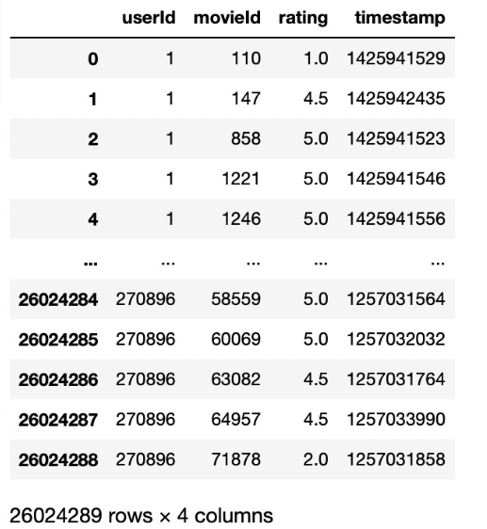
Continued…
The contents of the IMDB ratings.csv dataset are described below

Slide 7
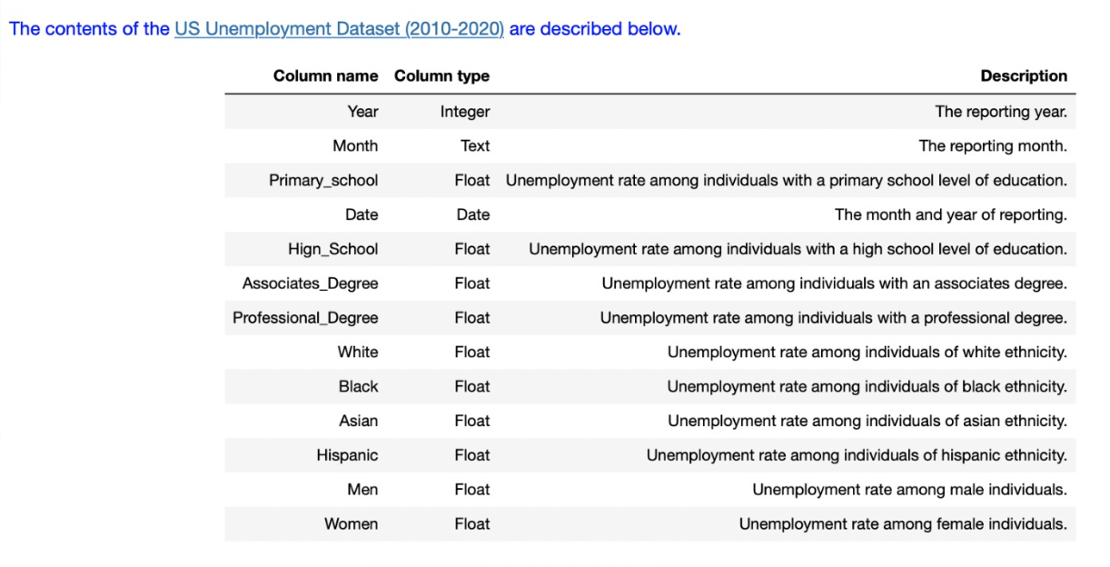
“Secondary Data: (B) Contextual dataset: US Unemployment Dataset (2010- 2020)”

Slide 8
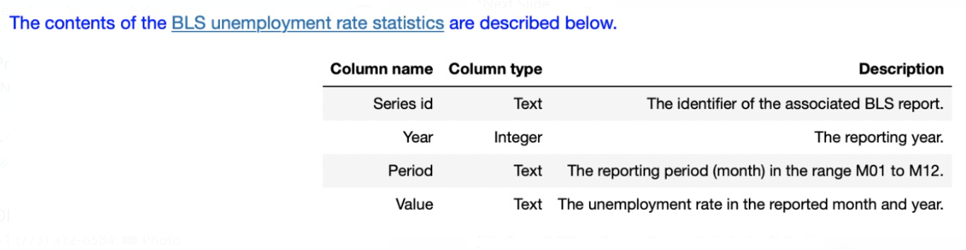
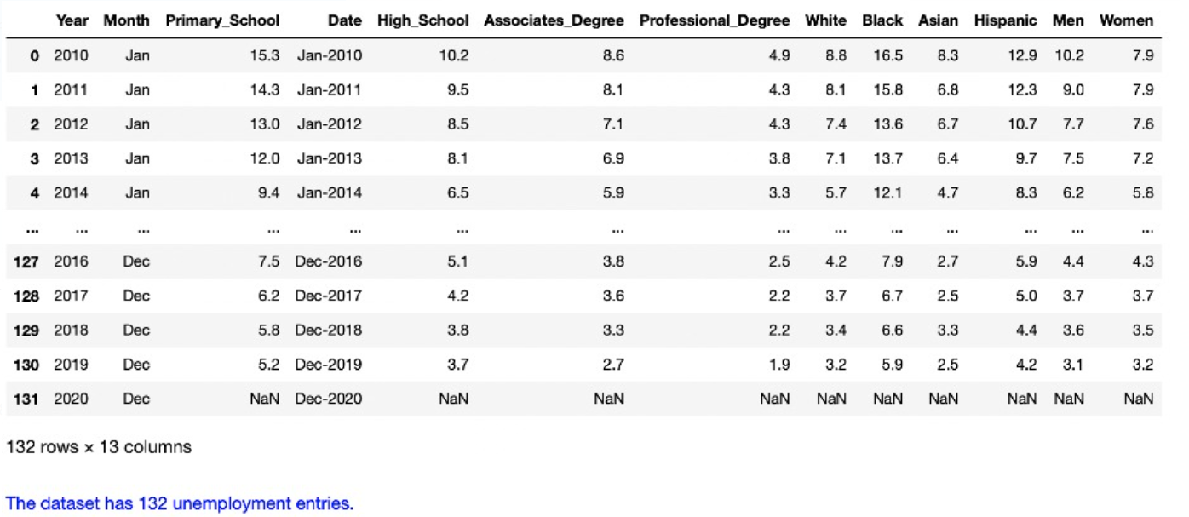
Secondary Data: (C) Bureau of Labor Statistics (BLS) Unemployment Rates (2010- 2020)

Slide 9
DATA PREPARATION STEPS
To produce an Analytic Base Table (ABT) data structure.
Data wrangling process: It consisted of the following steps:
Discovery
Structuring
Cleaning
Validating
Enrichment
Aggregation
Integration
publishing.

Slide 10
Data Preparation Steps: Analytic Base Table (ABT) data structure
To prepare the data in the four datasets for analysis and use in the modeling process
The project employed an 8-step data wrangling process to produce an Analytic Base Table (ABT) data structure.
Note: Whenever feasible, as much as possible of the entire dataset should be prepared for analysis, with extraneous variables being removed at the end of the data preparation process.

Slide 11
Data Wrangling Steps: (A) Discovery
Datasets were explored initially in its raw form, to better understand the dataset
With better insights into the nature of the data, better questions can be asked of it for business purposes.
As a result, a movie was defined as a motion picture that had its first public release carried out in a movie theater. This excluded movies never released to the public or released initially on video.

Slide 12
Structuring
Data structuring techniques were used to:
normalize the data
To reduce complexity
-For example, it was ensured that each variable contained an atomic value, and datatype conversions were applied where variables were not assigned the correct datatypes.

Slide 13
Cleaning
Data cleansing or data cleaning is the process of detecting and correcting corrupt or inaccurate records from a given dataset
The data cleaning process had outliers stripped from the datasets
For instance, in the given data movie with movie revenue value as 0 were considered as outlier and stripped off
Also movies released straight to video or with any status other than RELEASED were also dropped from the analysis
Entries with missing values for required entries, such as the release date were also excluded.
After data cleansing our primary dataset was reduced from 45,466 individual movie entries to 7,406 entries.

Slide 14
Validating
Data validation refers to the process of ensuring the accuracy and quality of data
This step is validating the results of the data cleansing process to ensure that the resulting dataset is still fit for purpose
This included verifying that categorical values, contained only acceptable values, that date variables had the correct datatypes, etc.

Slide 15
Enrichment
Data Enrichment allows companies to make their raw data useful
It also allows businesses to add additional as well as missing data to the original data set to make it more useful.
Here in this step we performed merging a dataset with third-party data from a reputable data source
Initial enrichment was performed by merging unemployment statistics with unemployment rates published by the Bureau of Labor Statistics.

Slide 16
Aggregation
Data aggregation is any process whereby data is gathered and expressed in a summary form.
When data is aggregated, atomic data rows typically gathered from multiple sources are replaced with totals or summary statistics.
For the aggregation step, user rating information by numerous users was summarized through the computing of aggregates grouped by individual movies.

Slide 17
Integration
Integration of dataset is performed to combine the required and useful information from the dataset
Once all datasets were cleaned and validated, they were combined into a single unified view, using common fields
For instance: movie identifier to associate movies with ratings, and both the year and the month of the reporting period to associate the datasets containing unemployment data and correlate them with movies based on the movie release data
The outcome was an Analytical Base Table to be used for analysis.

Slide 18
Publishing
After performing all the above the steps, we need to display the resulting data
The outcome of the data wrangling process was a combined dataset, containing clean and validated data, that was formally made available for data analysis and the model building stages of the project.

Slide 19
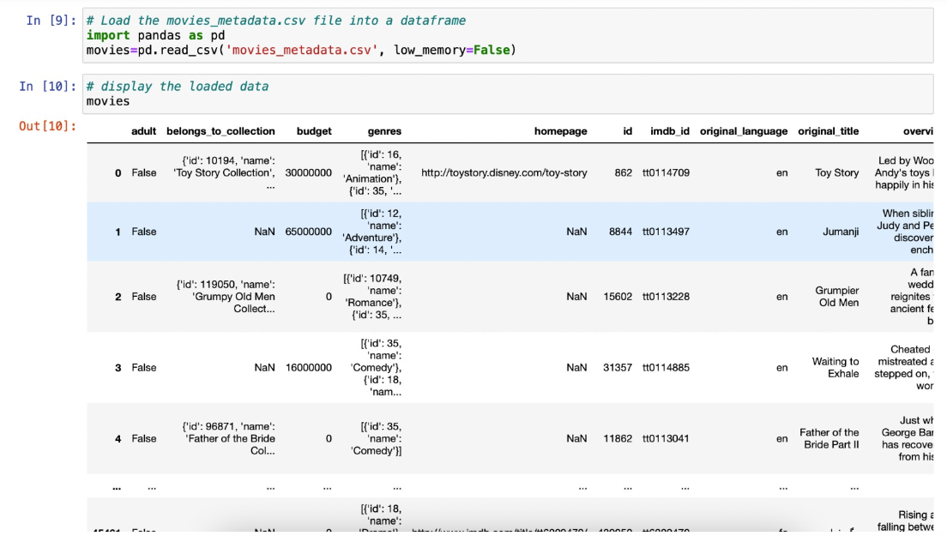
Implementation
Loading the Dataset

Slide 20
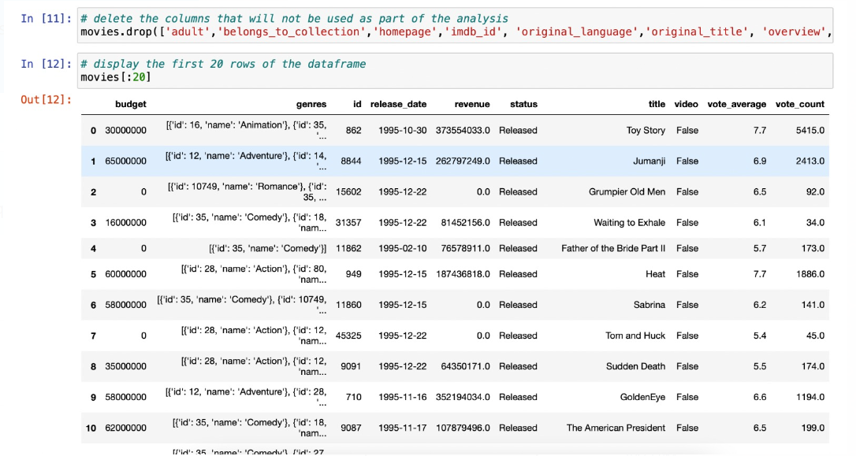
Continued..
Here we perform Data Cleansing
Like this we need to perform required data preparation steps for the given datasets

Slide 21
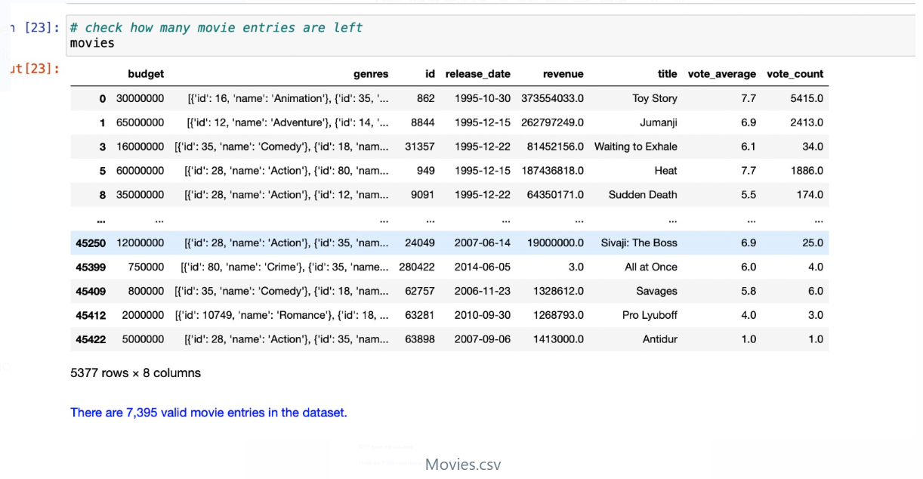
Continued..

Slide 22
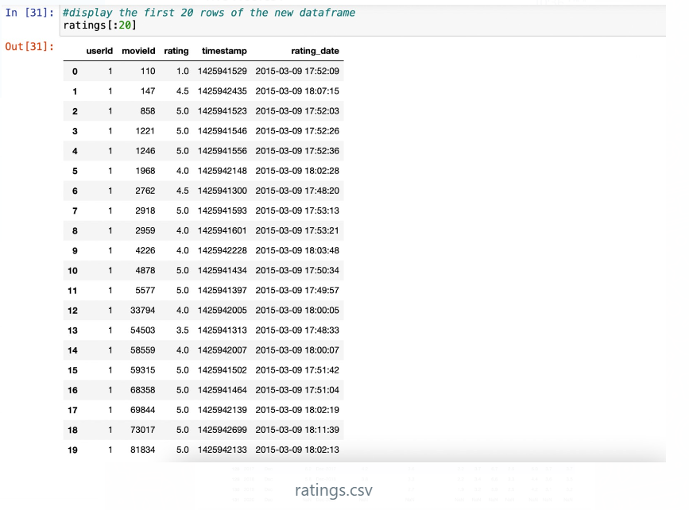
Continued..

Slide 23
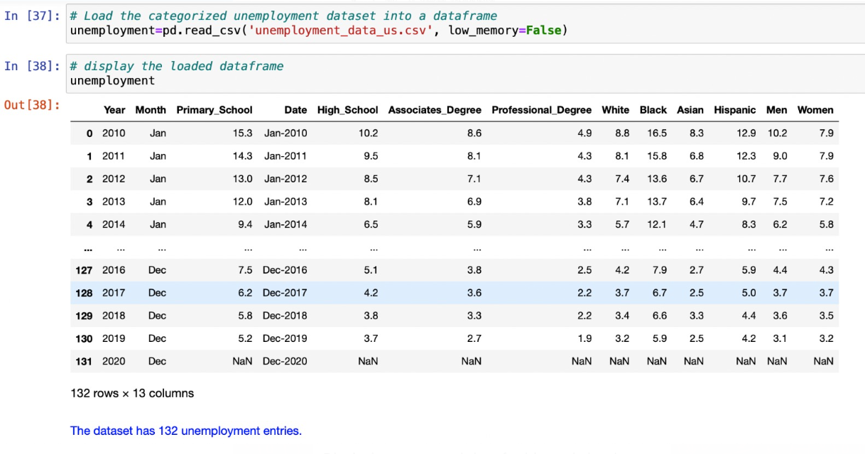
Continued..

Slide 24
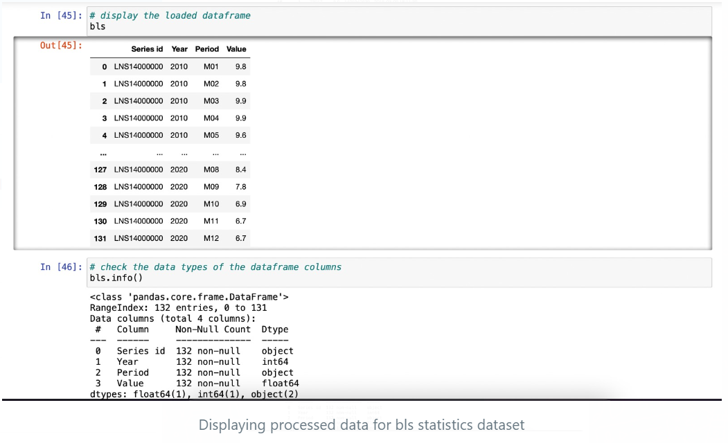
Displaying processed data for bls statistics dataset

Slide 25
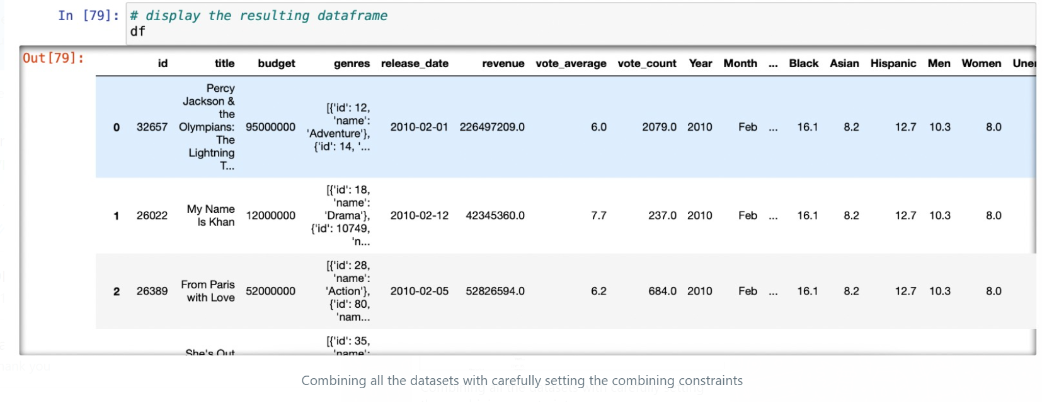
Combining all the datasets with carefully setting the combining constraints

Slide 26
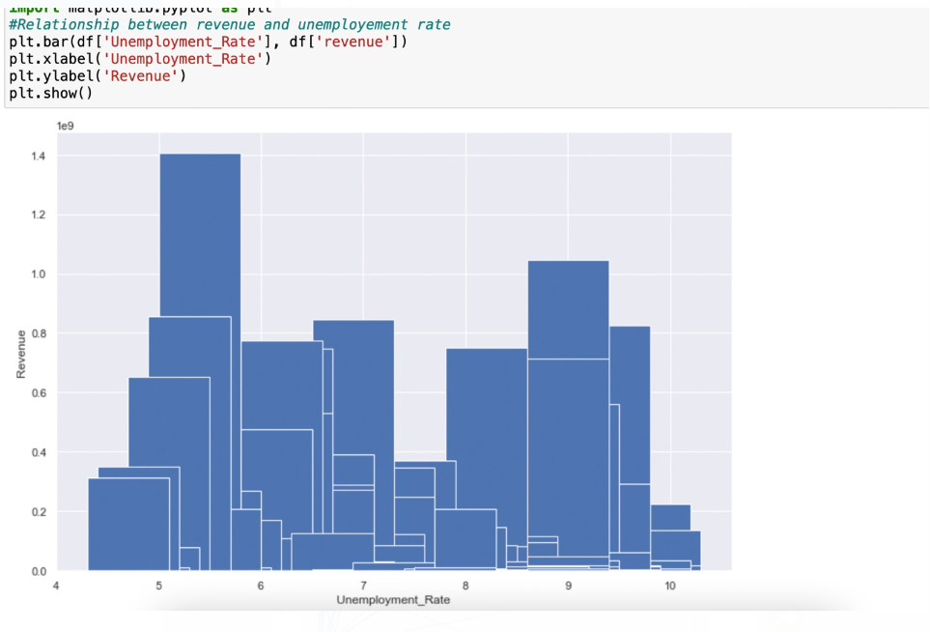
Results
VIZUALIZATION AND ANALYSIS

Slide 27
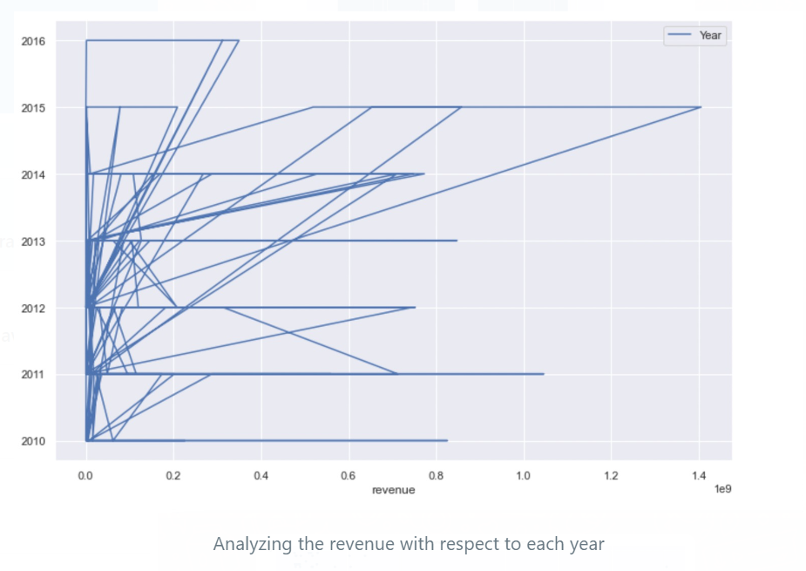
Analyzing the revenue with respect to each year

Slide 28
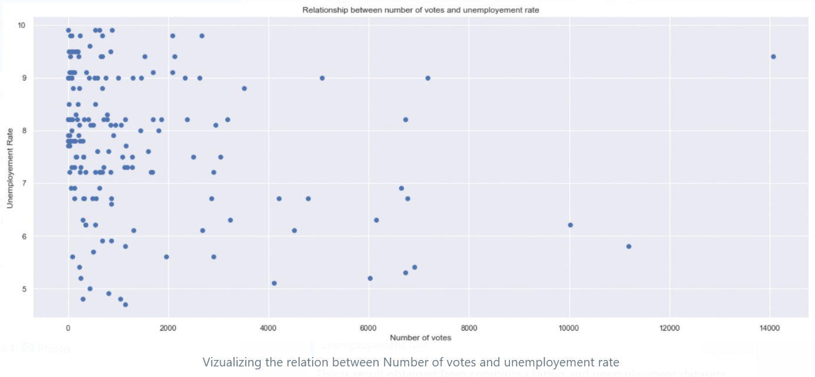
Visualizing the relation between Number of votes and unemployment rate
This is result obtained from combining rating and unemployment datasets

Slide 29
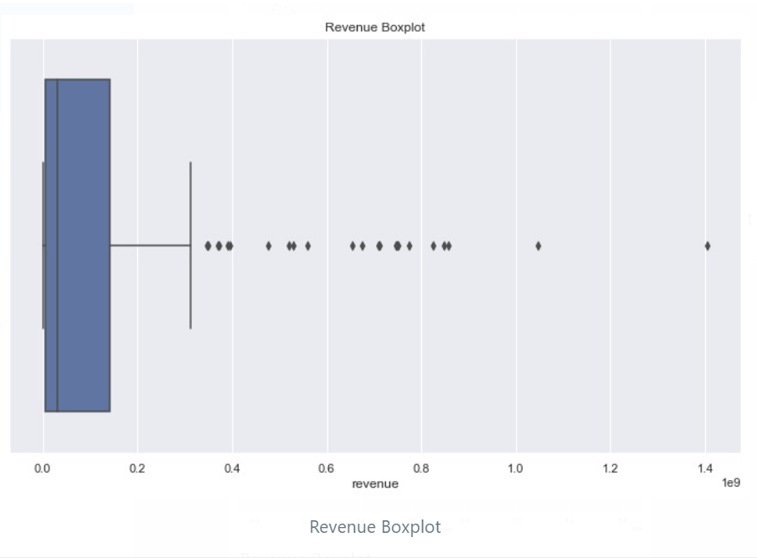
Revenue Boxplot

Slide 30
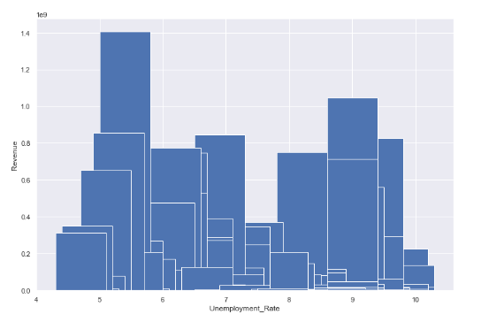
EXPLORATORY DATA ANALYSIS (EDA)
Unemployment Rate VS Revenue
Movies that earned higher revenue tend to have lower employment rates.

Slide 31
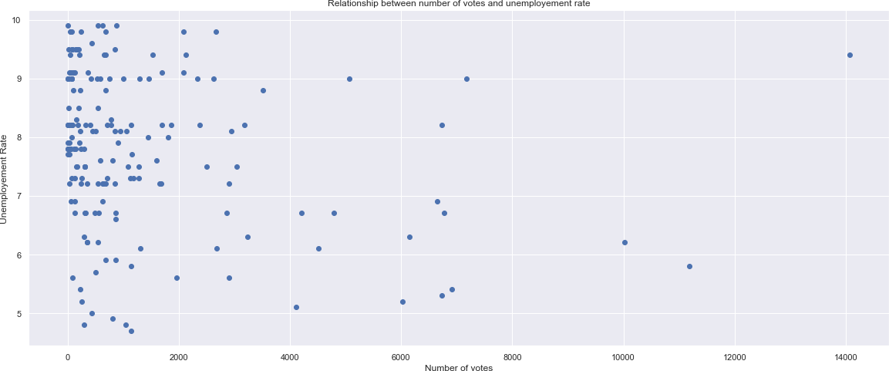
Unemployment Rate VS Number of Votes

Slide 32
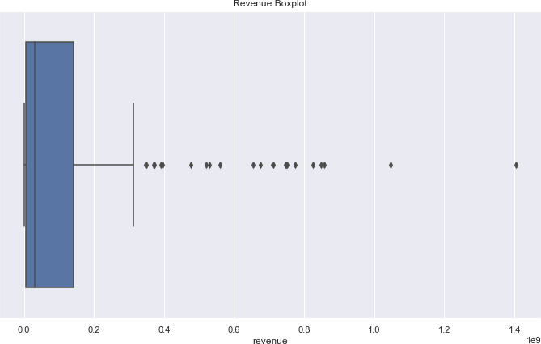
Revenue Boxplot

Slide 33
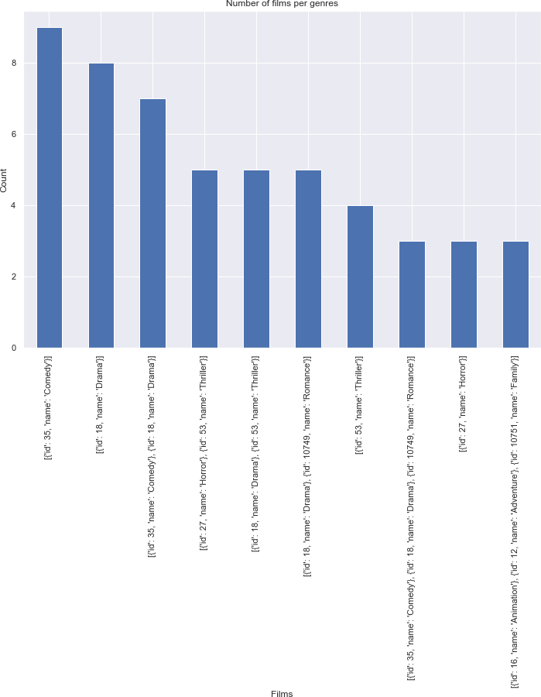
Number of films per genre
Most movies are of the comedy genre followed by thriller

Slide 34
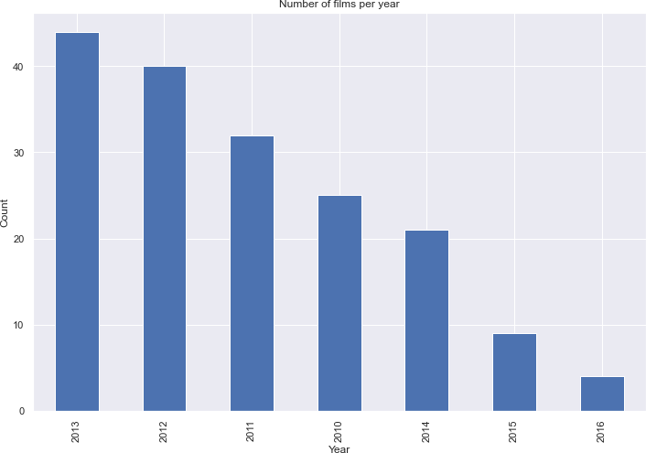
Number of films per year
Most movies were released in the year 2013 in comparison to various years (these statistics were framed from the data we had)

Slide 35
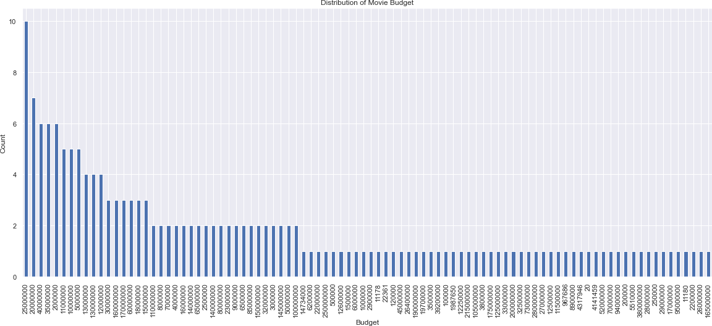
Distribution of Movie Budget
There was a good amount of high-budget movies at the box office

Slide 36
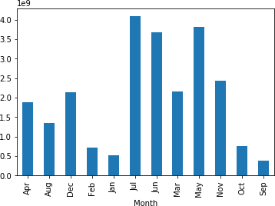
Movie released in a given month
Movies which were released in summer tend to create more money whereas the ones which were during the peak wintertime tend to make less revenue in comparison.

Slide 37
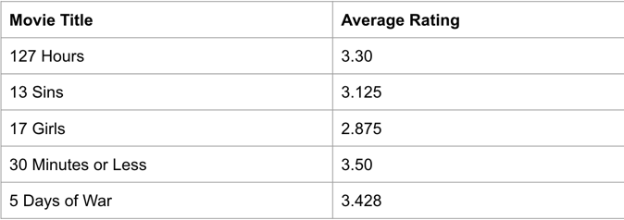
Movies with highest Average Rating

Slide 38
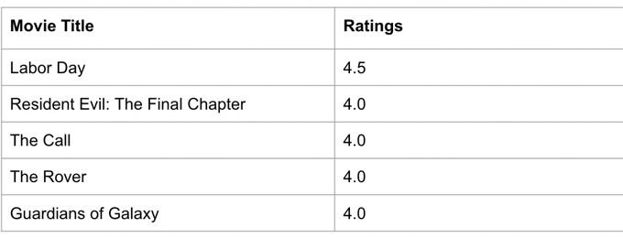
Movies with highest Ratings

Slide 39
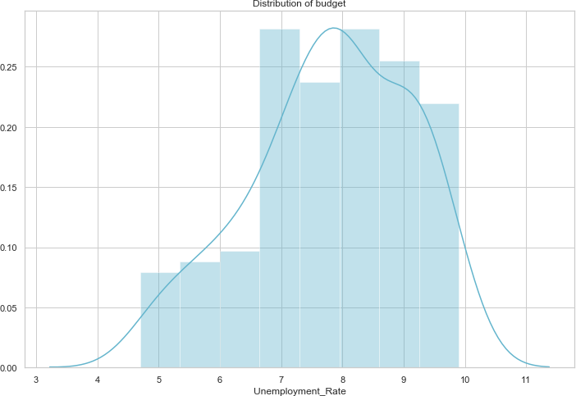
Distribution of budget
Movies with a good amount of budget tend to show median unemployment rate

Slide 40
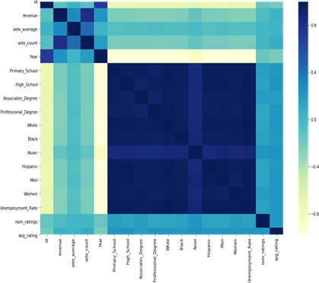
Correlation matrix
This shows how various variables are correlated to each other and how effective is each feature on every other feature.

Slide 41
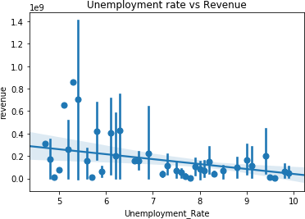
Unemployment Rate VS Revenue
Unemployment rate increases when the movie fails to make a good amount of profit or is unable to create a good amount.

Slide 42
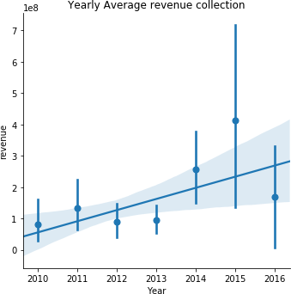
Average Revenue collection based on Year
In year 2015 the most average revenue was collected, most movies performed the best during that duration.

Slide 43
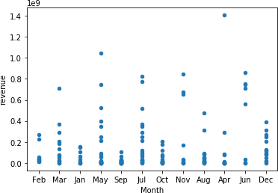
Revenue Scatter plot
We can find a movie in April created a good profit shown as an outlier in the plot above, but overall there was a good quantity of movies released in July

Slide 44
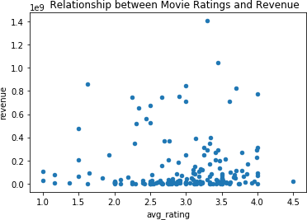
Relationship between Movie Ratings and Revenue
This shows that even when the movie rating was the movie did make a good revenue on box office and few movies which had good movie reviews failed terribly at the box office.

Slide 45
References
[1] T. Gebru, J. Morgenstern, B. Vecchione, J. Vaughan, H. Wallach, H. Daume III, and K. Crawford, “Datasheets for datasets,” arXiv:1803.09010v7 [cs.DB], Mar 2020.
[2] https://levelup.gitconnected.com/random-forest-regression- 209c0f354c84
[3] https://www.kaggle.com/aniruddhasshirahatti/us- unemployment-dataset-2010-2020/metadata.
[4] https://www.kaggle.com/stefanoleone992/imdb-extensive- dataset/metadata.
[5] The United States BLS Statistics data: https://data.bls.gov/cgi-bin/surveymost?bls.

